Slide 1
Video Analytics - SBI
Powered By - Microsoft Corporation Pvt Ltd.

Slide 2

Problem Being Solved:
Video analytics Solution to remotely monitor ATMs, Branches, and Offices as a proactive measure

Slide 3
Approach taken to create the model:
Open source model based learning , custom CCTV clips ,custom CCTV clips , custom weapon training ,head count.

Slide 4
Prerequisites
Fixed resolution + FPS of Video footage:
480pixel+30FPS

Slide 5
Any supporting assumptions, functional requirements(FR) and non-functional requirements(NFR):
Installing open cv
Telegram bots
Wrapper packages
Requirement in .txt file

Slide 6
Reason why your solution should be considered:
The capabilities of video analytics are very beneficial within a CCTV system. Video analytics uses computer algorithms to monitor real-time video captured by CCTV cameras to enhance security surveillance of people, vehicles, objects, and their associated behaviors within a camera’s view which can keep a deep eye check on ATMs and offices.

Slide 7
Source code (Github Repository Link)
https://github.com/WTS007/Video-Analysis.git

Slide 8
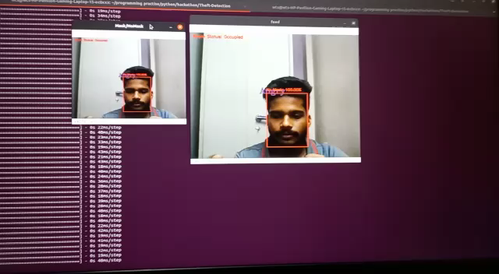
Demonstration Video showing the
functionalities/working of the solution.

Slide 9
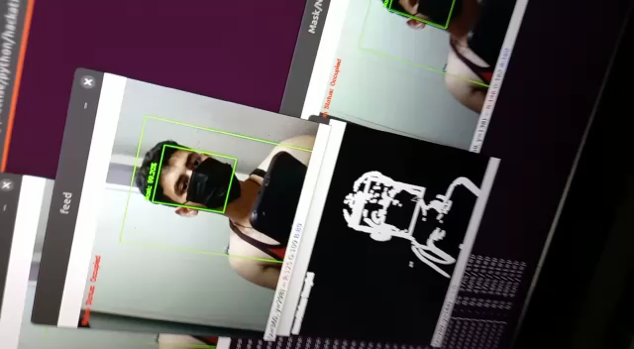
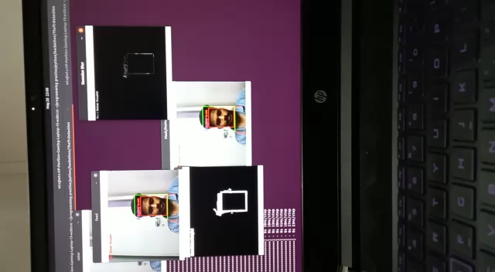

Slide 10

Submitted By :
Email :
Mobile No:
Team WTS
lowendgaming00@gmail.com
934855470

